Slide 1
Harnessing Online Behavioral Data for Public Health
Henry Kautz
Professor, Department of Computer Science
University of Virginia, Charlottesville

Slide 2
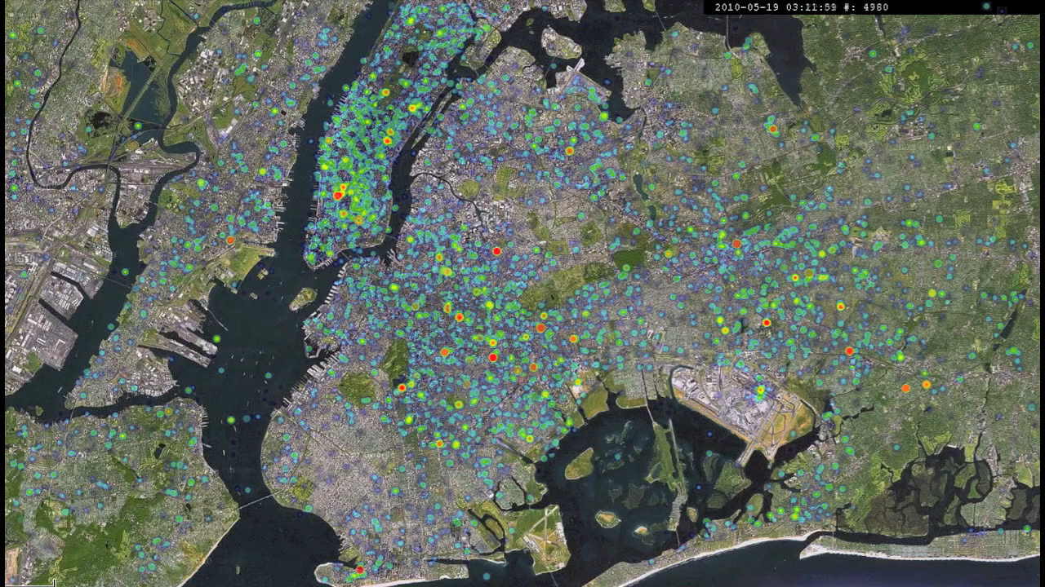
Dimensions
Data type:
  Social media posts
  Internet search data
Data features:
  Content: text, images, videos
  Meta-content: time, location, user profile
User consent:
  None: aggregate over all queries
  None: linked sets of queries
  Consented subjects
Track and predict:
  Trends / correlates / causes
  Individual people / entities
Health concern
  Infectious disease
  Mental health
  Others: drugs, diet, food poisoning, …
24 Hour Heat Map of Tweets, NYC

Slide 3
Google Flu Trends
Search | Content | Aggregate | Trends | Influenza
2009, J. Ginsberg et al., Detecting influenza epidemics using search engine query data
Trained by correlating historical logs of web search 2003-2008 with CDC data]
Provides 3-week lead over CDC results

Slide 4
Birth of Twitter Health Informatics
Social Media | Content | Aggregate | Trends | General
2011, Michael Paul & Mark Dredze, You Are What You Tweet: Analyzing Twitter for Public Health
Latent Dirichlet distribution model
  Document (tweet textual content) = distribution over ailments
  Ailment = distribution over symptoms / treatments
  Symptoms / treatments = distribution over words

Slide 5
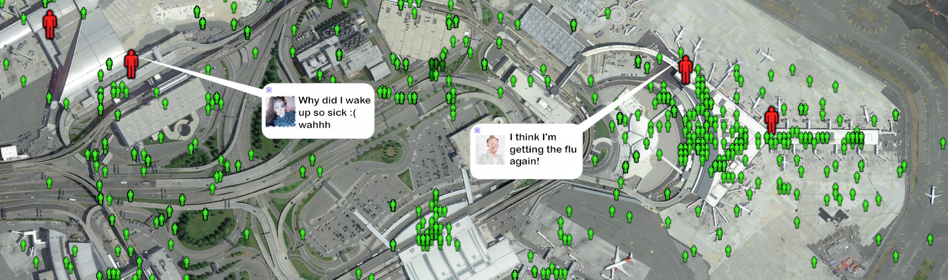
Scaling Up Twitter Health
Social Media | Content+Meta | Linked | Trends | Influenza
2013, Adam Sadelik & Henry Kautz, Towards Understanding Global Spread of Disease from Everyday Interpersonal Interactions
Word trigram SVM model, location metadata
Tracked 600,000 Twitter users traveling between 100 metropolitan areas
Predicted weekly influenza rate in cities with high accuracy (within 7% true rate more than 95% of the time)

Slide 6
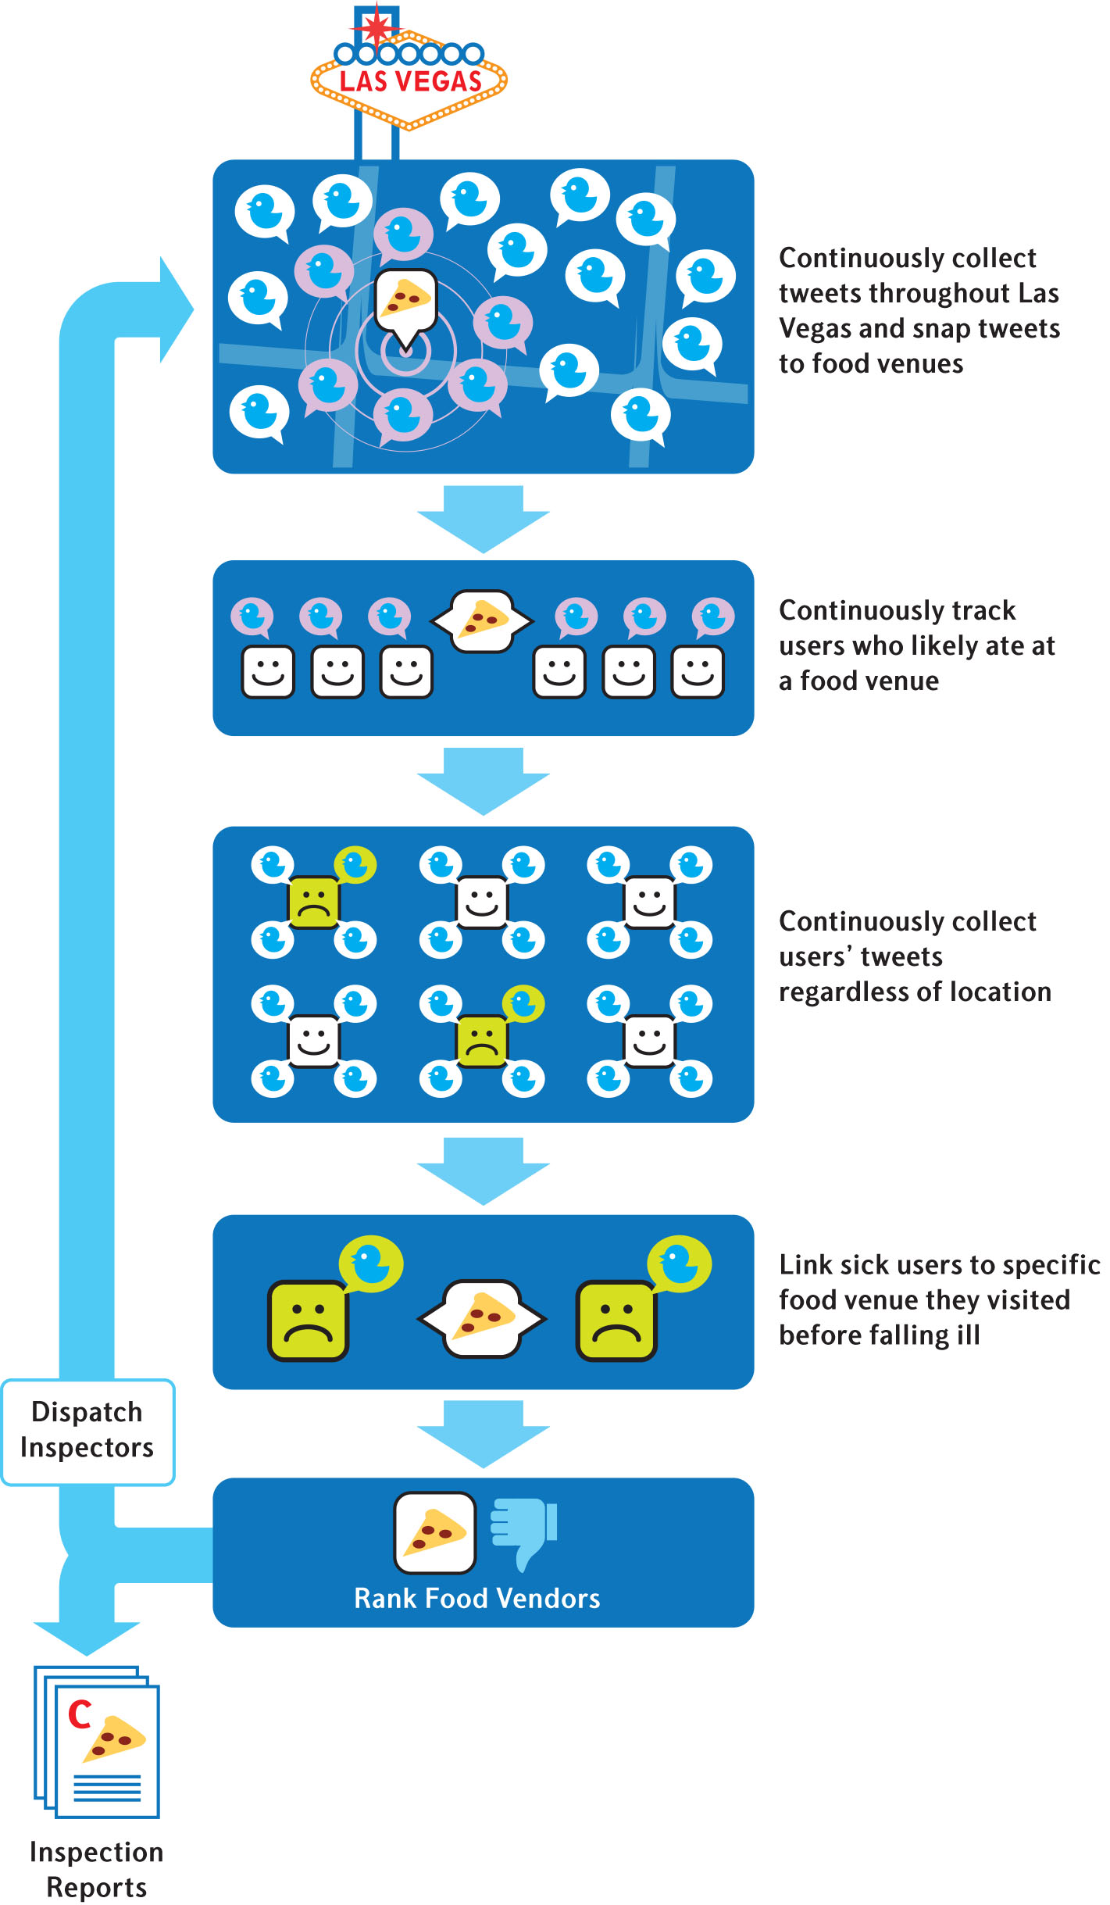
Locating Sources of Food-borne Illness
Social Media | Content+Meta | Linked | Individual | Food-borne
2016, A. Sadilek et al., Deploying nEmesis: Preventing Foodborne Illness by Data Mining Social Media.
3-month trial by Southern Nevada Health District (Las Vegas)
  Paired control venues also inspected
  71 adaptive / 71 control inspections
  Inspectors blind to which are
  adaptive
Adaptive inspections uncovered 50% more violations

Slide 7
From Twitter to Web Search
Web Search | Meta+Content | Linked | Individual | Food-borne
2018, A. Sadilek et al., Machine-learned epidemiology: real-time detection of foodborne illness at scale
Uses Google Search content + GPS location to identify restaurants
Differential privacy to hide user identities
Twice as effective as baseline

Slide 8
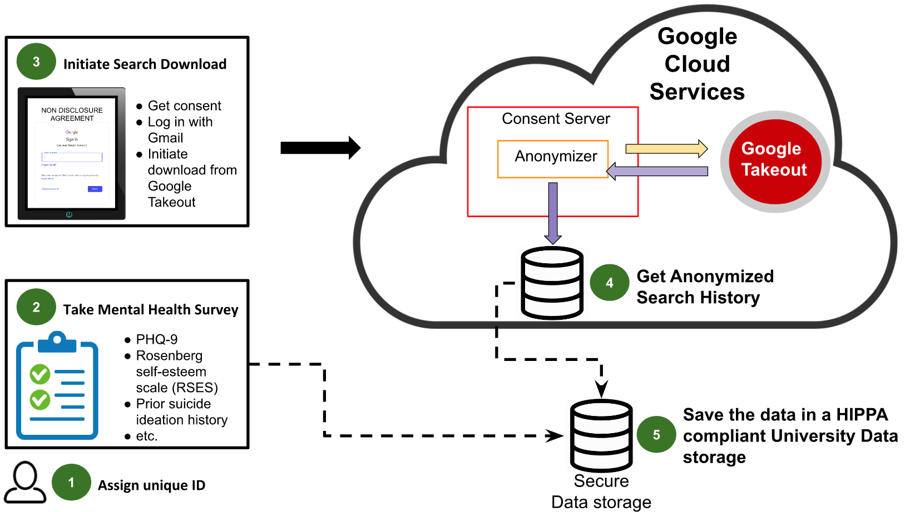
Google Takeout: Your One-Stop Shop
Takeout | Content+Meta | Consented | Individual | Mental Health
2020, Anis Zaman et al., Estimating Anxiety based on individual level engagements on YouTube & Google Search Engine

Slide 9
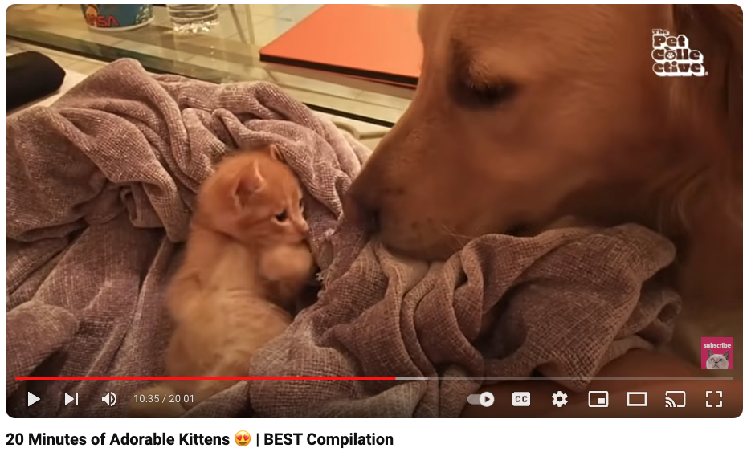
Online Data Features
Google search search queries → category labels using Google Cloud NLP API
  “election results” → NEWS
YouTube videos → YouTube category label
  “20 Minutes of Adorable Kittens” → PETS & ANIMALS
Timestamps of activities
Temporal distribution of activities

Slide 10
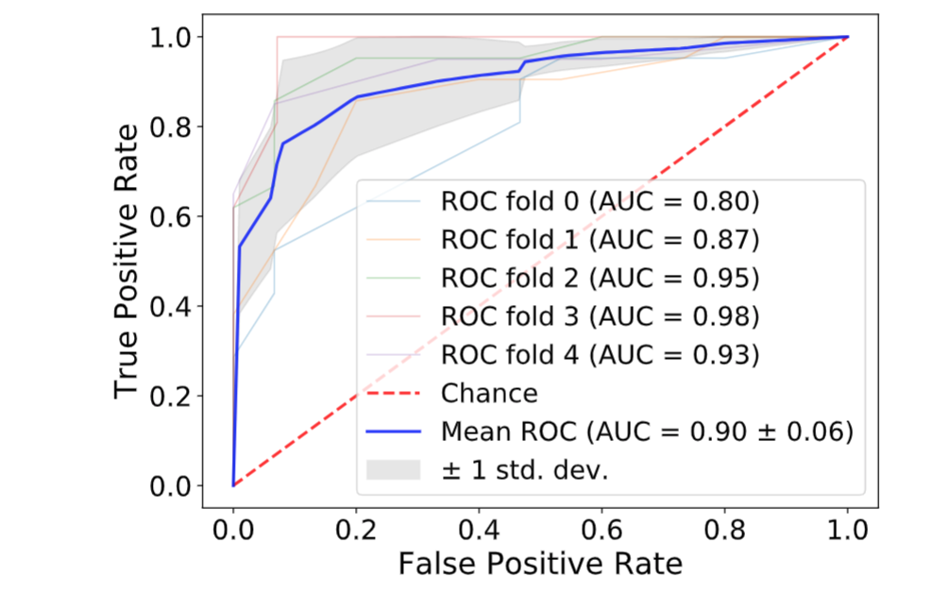
Anxiety Prediction
Given online data at time T, detect anxiety (GADS-7>9) at time T
Random Forest
5-fold cross validation
Notes:
Since RF performed the best, we plotted the ROC for the RF
The area under the curve, called AUC, tells us how well the model is performing
AUC goes from 0 to 1. 1 → mode is perfect

Slide 11
Harnessing Internet Search Data as a Potential Tool for Medical Diagnosis
2024, G. Downing et al., Innovation Horizons
Analysis of 2500 papers from PubMed on use of web search data
Identified research categories:
  Aggregate anonymous queries – many studies but of limited usefulness
  Linked sets of queries by anonymized individuals – can find correlations among symptoms, diseases, and other behavior
  Queries from consented individuals – most powerful in principle, but vastly smaller (dozens versus millions of subjects)
Identified popular analysis tools and models
Researchers should also explore non-PubMed CS publications
  WSDM – International Conference on Web Search and Data Mining
  https://SemanticScholar.org

Slide 12
Pilots
Unlock the potential of consumer and patient internet search data as a valuable diagnostic tool
Revolutionize early disease detection and the delivery of personalized health information
Respect patient privacy and consent
12-month pilots
4 awards to date

Slide 13
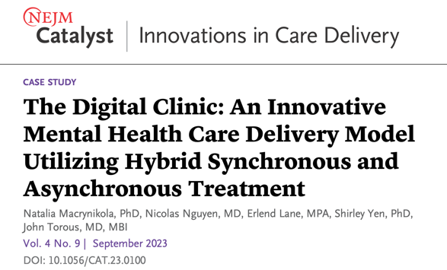



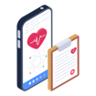


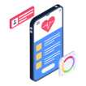
Internet Search Data and The Digital Clinic
Referral from primary care
or the community
Pt sees a clinician for weekly virtual therapy sessions
Digital Navigator reviews pt data & shares insights with clinician
Digital Navigator
checks in weekly with pt to facilitate app engagement
Pt uses mindLAMP app for self-monitoring & skills practice between sessions;
app also collects digital phenotyping data
Torous, J., Wisniewski, H., Bird, B. et al. Creating a Digital Health Smartphone App and Digital Phenotyping Platform for Mental Health and Diverse Healthcare Needs: an Interdisciplinary and Collaborative Approach. J. technol. behav. sci. 4, 73–85 (2019).

